Slide 1



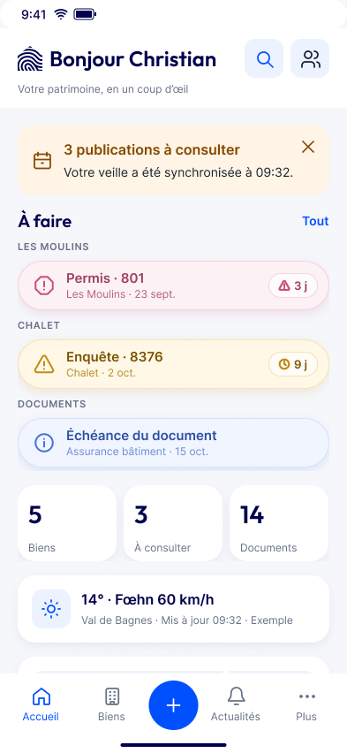




Bat-ID catches it. Can Sophie understand it?
A permit touching her parcel is published
Bat-ID spots it and alerts her
Does she get it in 5 seconds?
Bat-ID x Hack VS 2026

Slide 2






Owners who understand in 5 seconds, stay.
Free
Paid
All
Decouverte
Averti
features kept
5 seconds = our target, inspired by the five-second test (Sova & Nielsen, The UX Five-Second Rules, 2013). Not a measured result.

Slide 3







The challenge:
Fewer drop-offs
in first uses
Value seen fast
make the first minutes count.
A reason to
come back
Averti
made clear
4
56
2
tabs
notification types
platforms

Slide 4




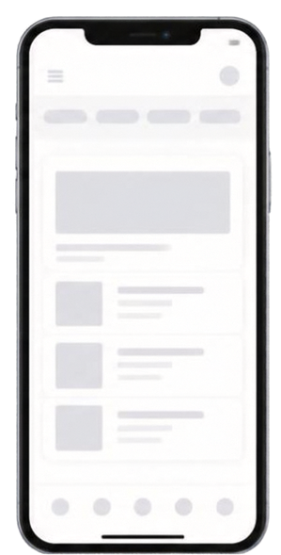


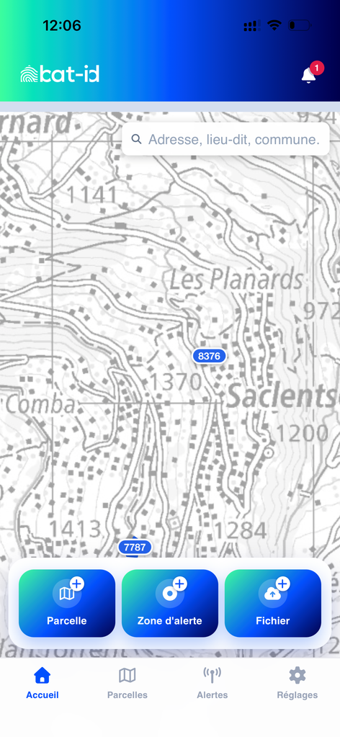










What we did.
Starting point
Our proposal
1
Dashboard page first
2
Parcel details in “Biens”
3
Essentiel or Detaille mode
4
Map moved, not removed
Every feature kept.

Slide 5
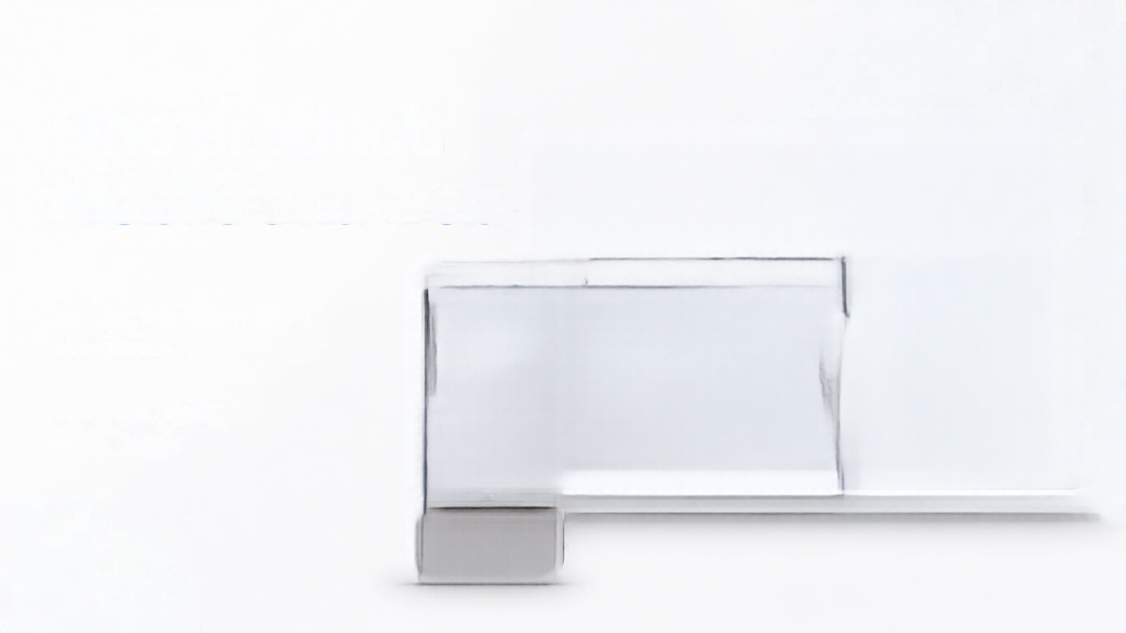


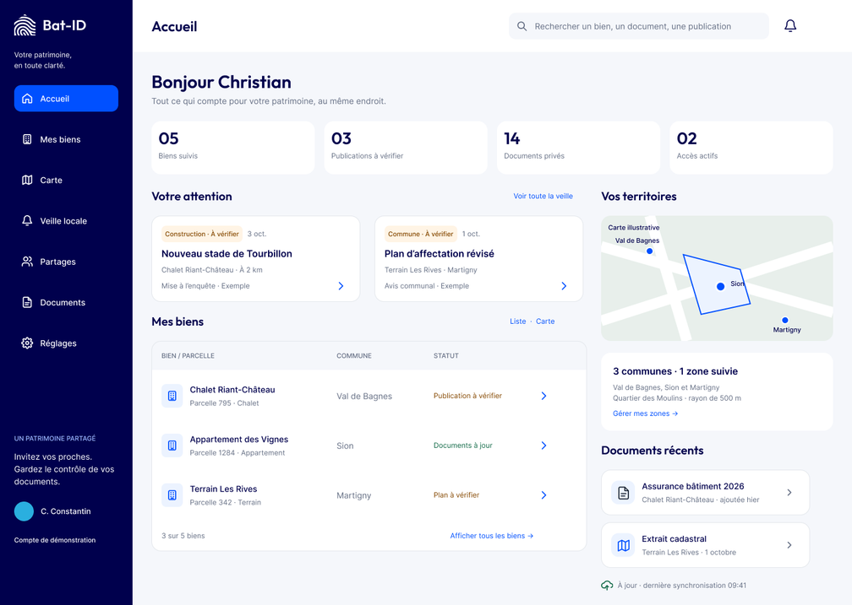


One logic.
Mobile and web.
Mobile: the essentials at a glance
Web: full detail,
more depth

Slide 6
The best fit for Bat-ID:
smooth, safe, complete.
Smooth
Safe
Full
2 in 1
Clear at a glance, fast to use
Every feature kept, no rebuild
Key docs fast, all done in-app
Mobile and web, one logic
Built, not just imagined: 147 screens · 52 components · 199 interactions
Thank you, Bat-ID team.
Merci.
Les disciples de St.Mudry

Slide 7
